Slide 1
Weekly meeting
8 22 2024
Ty Bottorff

Slide 2
Outline
MT variants & epigenetics from reseq

Slide 3
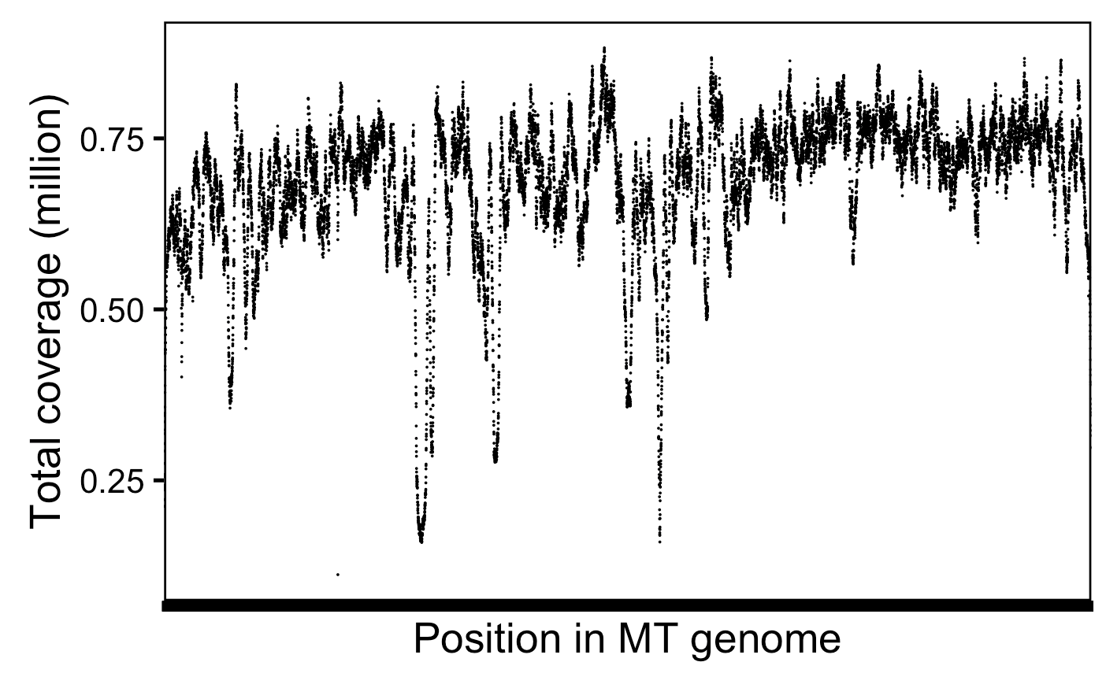
With reseq, cover MT genome to ~680k X depth
Notes:
# mean across positions and libs is 13,697 reads covering a specific position per lib, so that's 50*13,697 = ~680k X depth or coverage
Got the same # doing sum(combined_coverage_data$coverage) / 16569 (MT genome size)

Slide 4
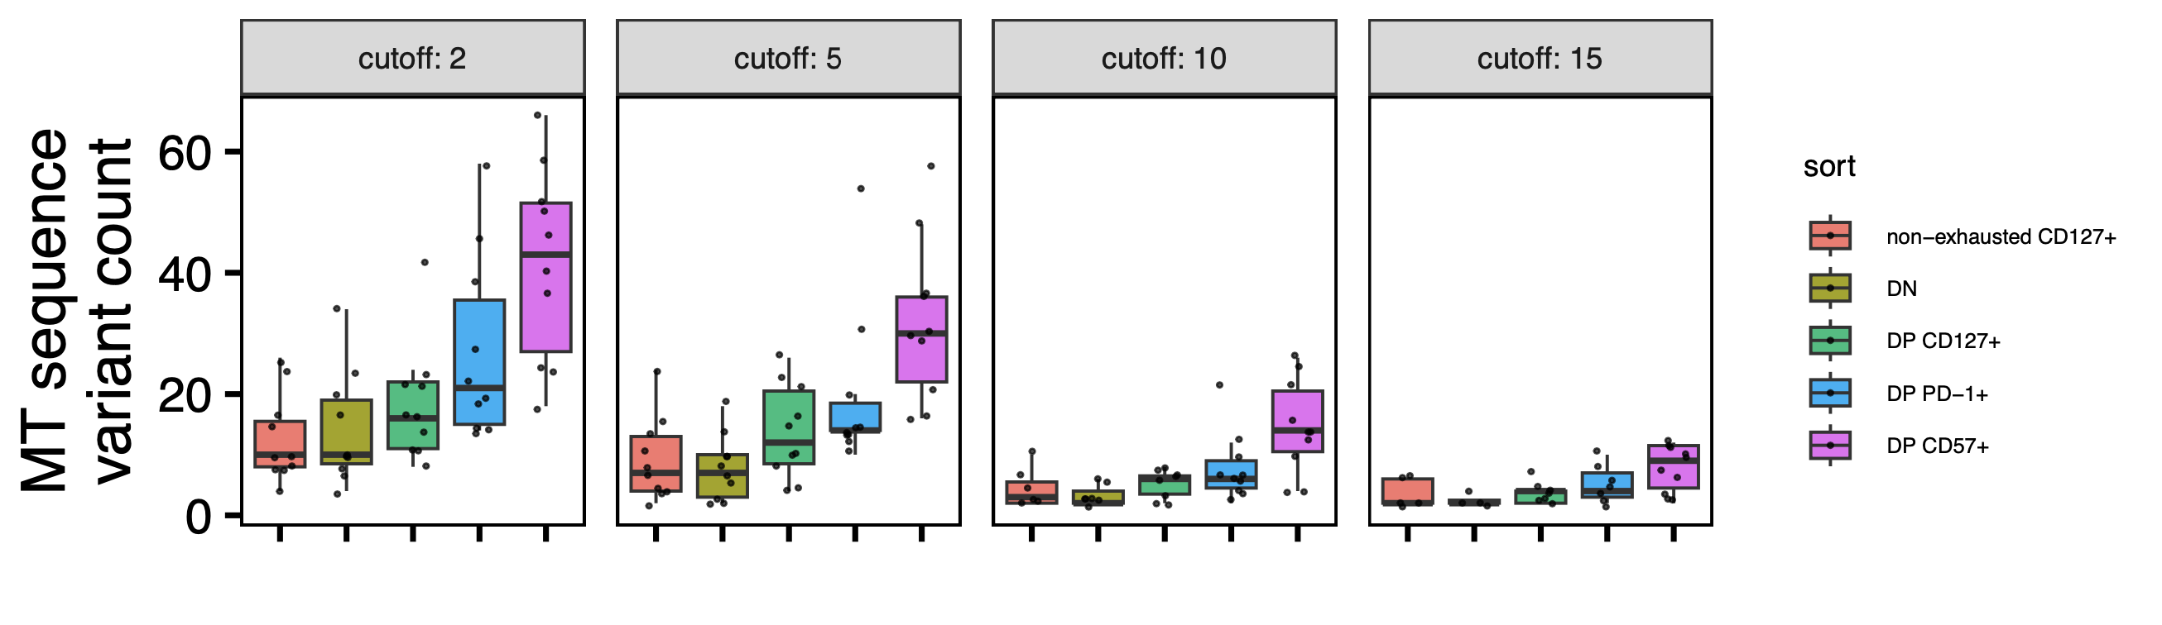
Still observe DP CD57⁺ having most MT SNV variants across various supporting read cutoffs
Cutoff means # of supporting reads for var or ref on both strands
*stats not tested
Notes:
Lowest min_var_freq used here
Cutoff of 2 is what I’ve used elsewhere/previously
Cutoff means # of supporting reads for var or ref on both strands (+/-)
filter(var_supporting_reads_on_plus_strand > cutoff,
var_supporting_reads_on_minus_strand > cutoff,
ref_supporting_reads_on_plus_strand > cutoff,
ref_supporting_reads_on_minus_strand > cutoff)

Slide 5
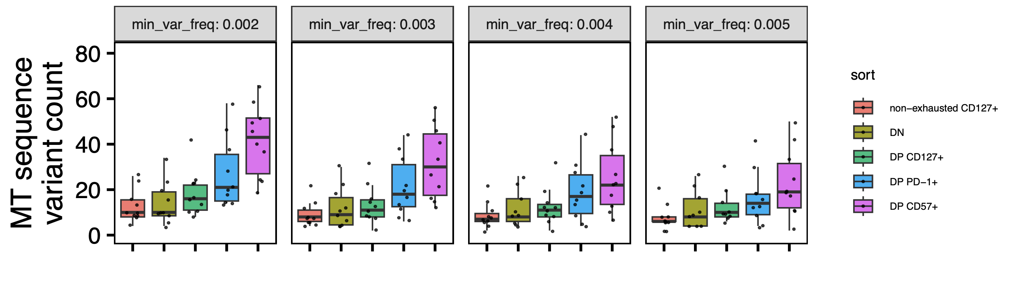
Trend strength increased with lower min_var_freq
0.003 is the highest min_var_freq with padj significances
(same comparisons as 0.002)

Slide 6
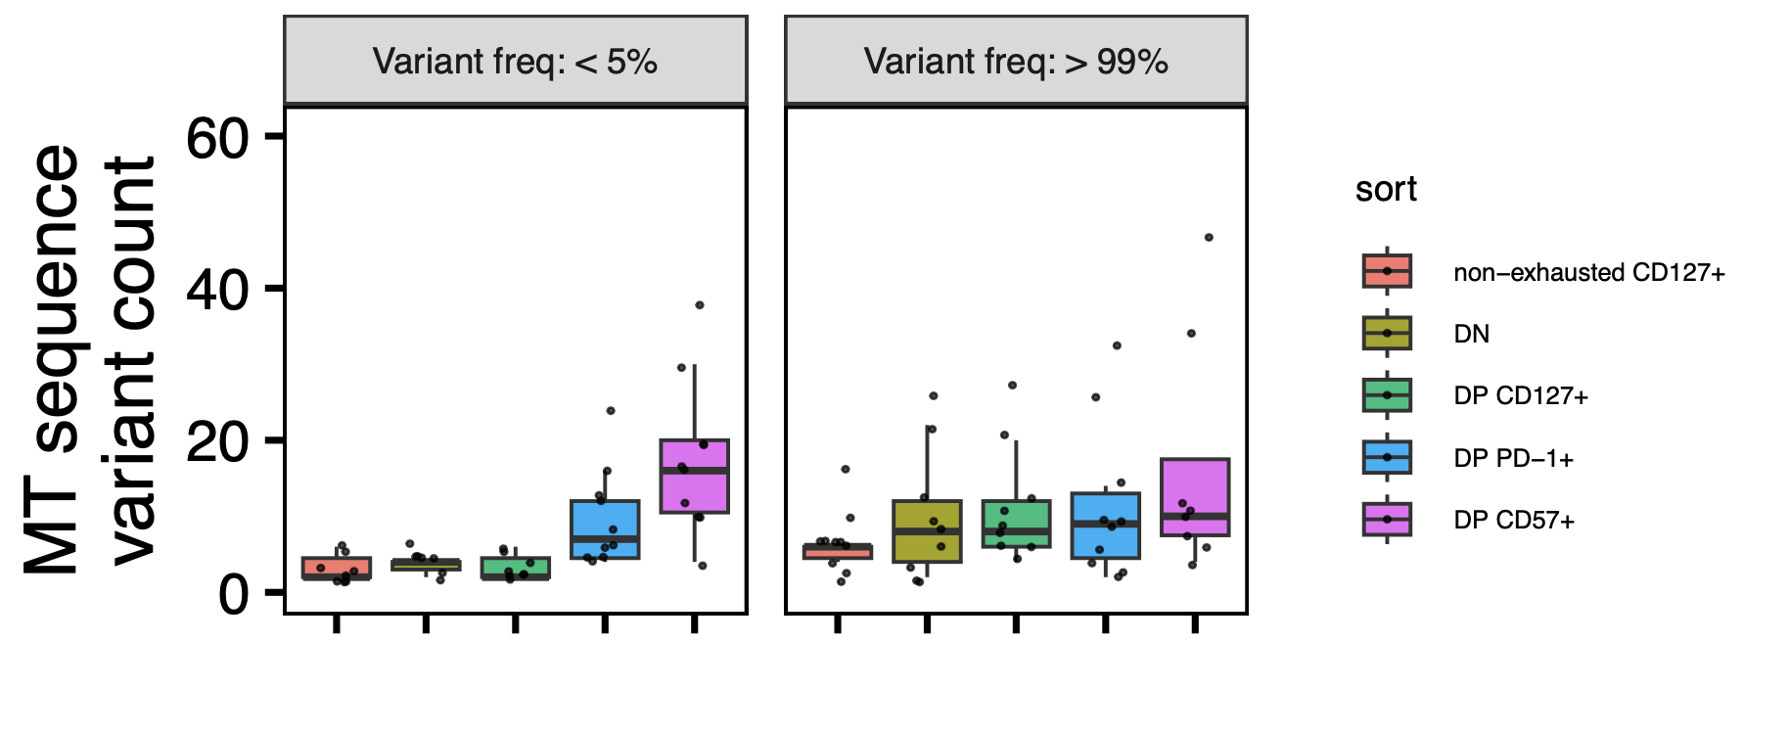
Do high freq variants mean a history of cell divisions and low freq ones mean recent cell divisions?
Notes:
Low freq vars could be in many cells but more heteroplasmic or in few cells but more homoplasmic… both meaning recent divisions?
Asking if interpretation is right, for high freq vars it’s really just that non-exh CD127 is low… then PD-1/CD57 high in low freq vars
Does this then place non-exh farther from DN than DN is from DP CD127+ in lineage space? And PD-1/CD57 closer than PD-1 and DP CD127?
maybe bimodal because quick process between loss and fixation?

Slide 7
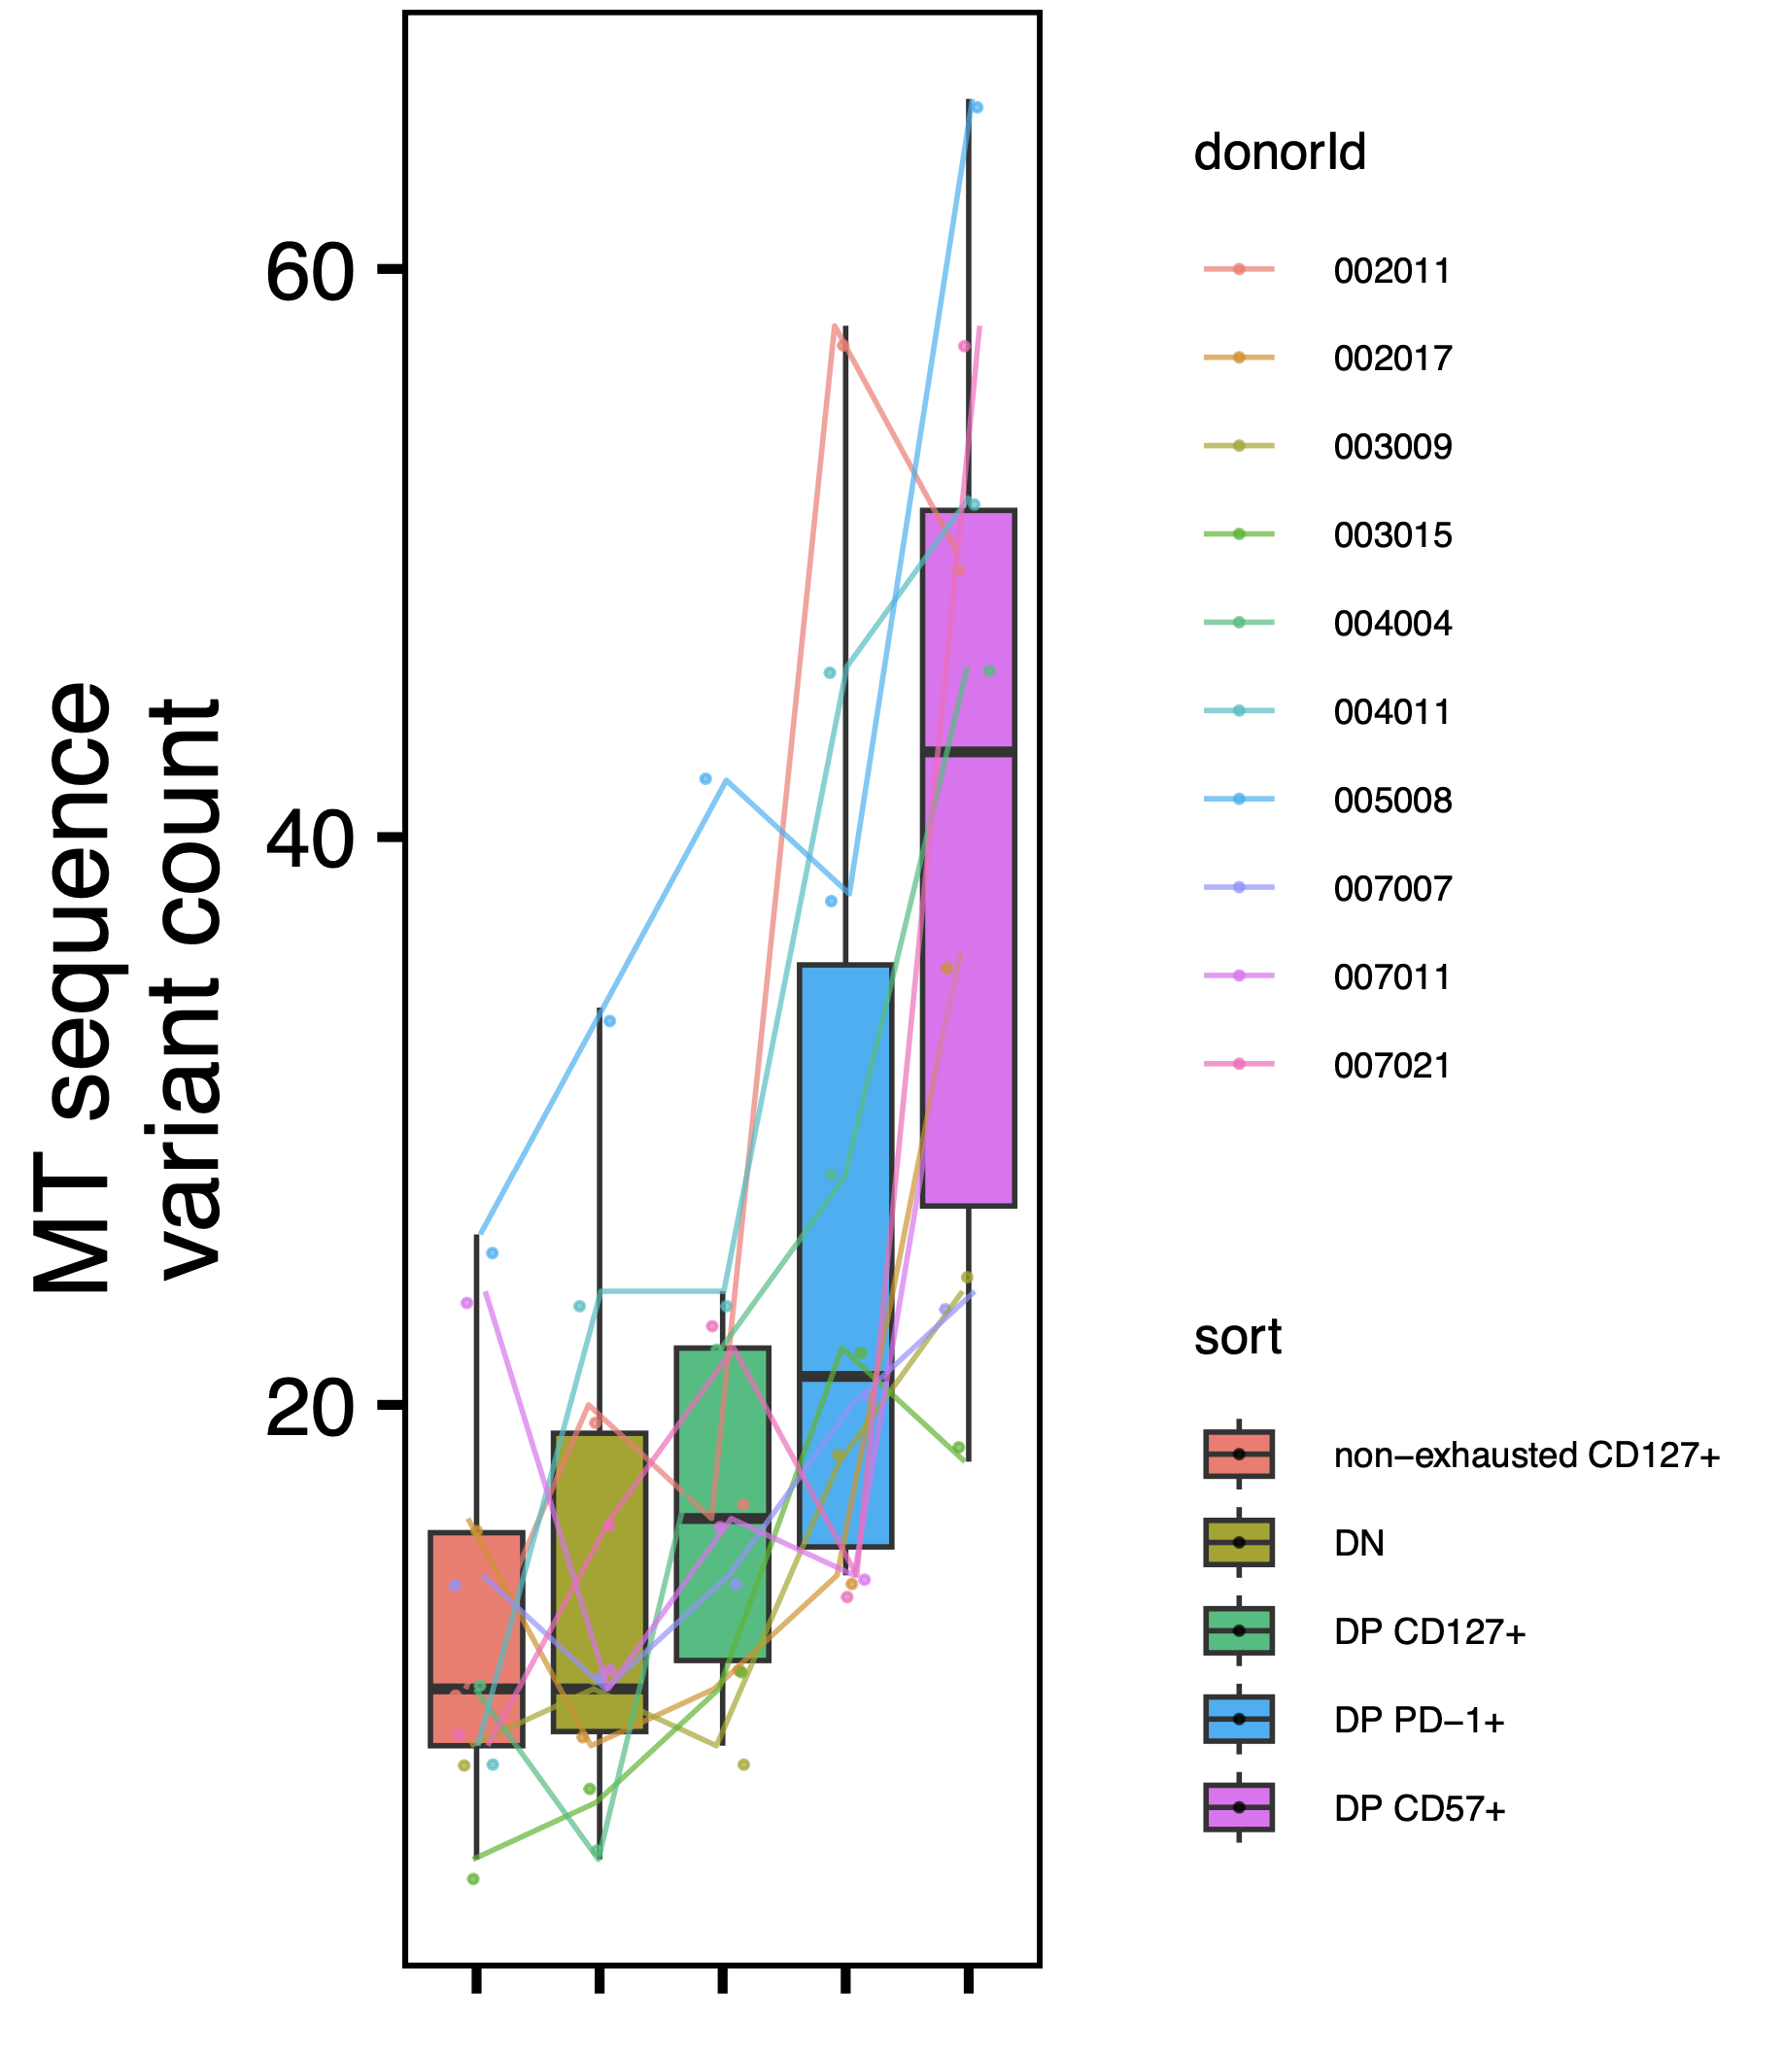
Paired wilcox tests have ~same significance conclusions, minimal donor effect
Notes:
So sort to sort variation > donor to donor variation?

Slide 8
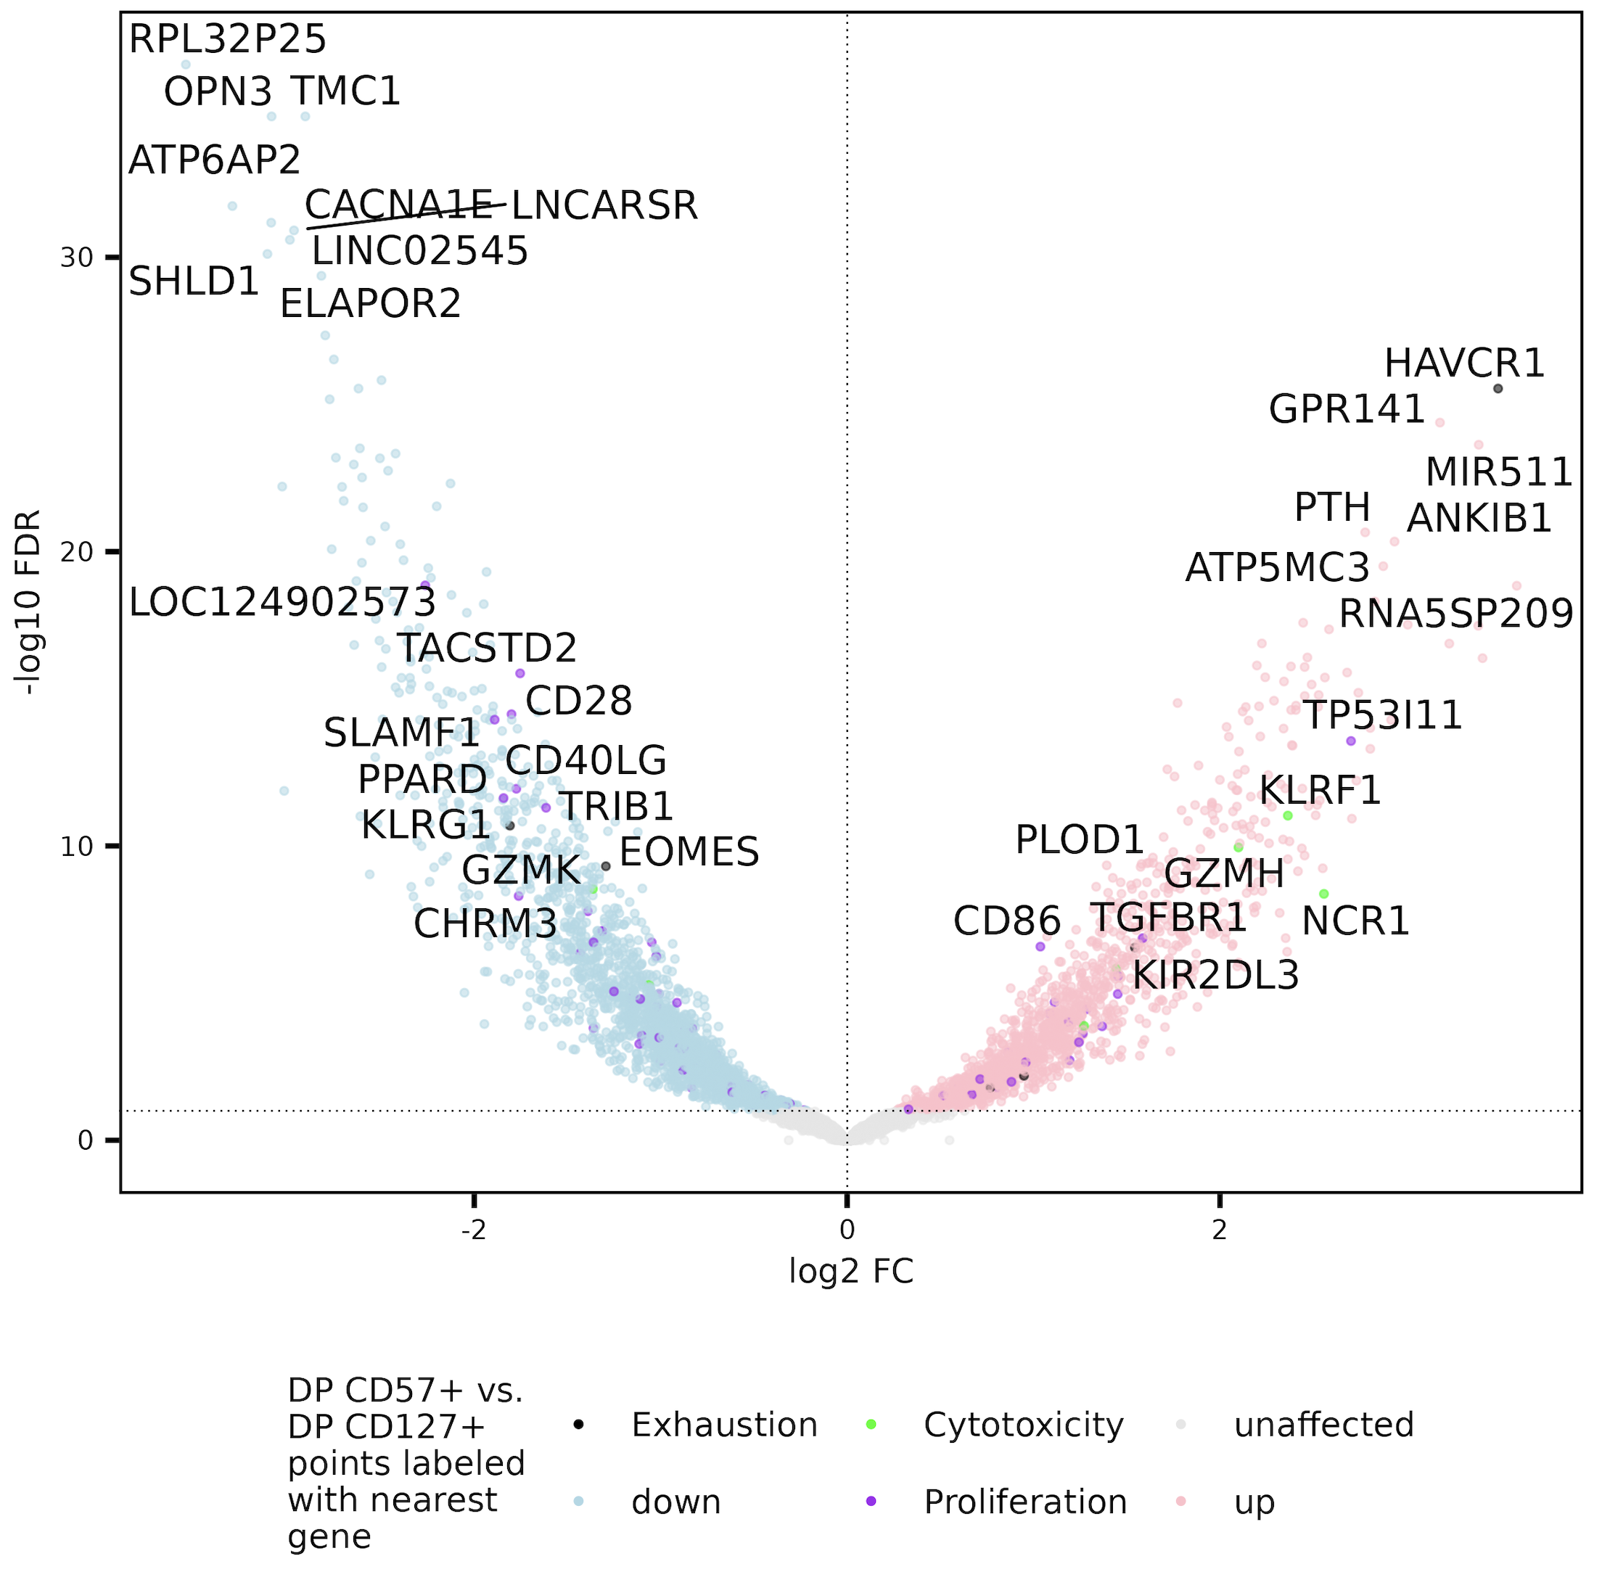
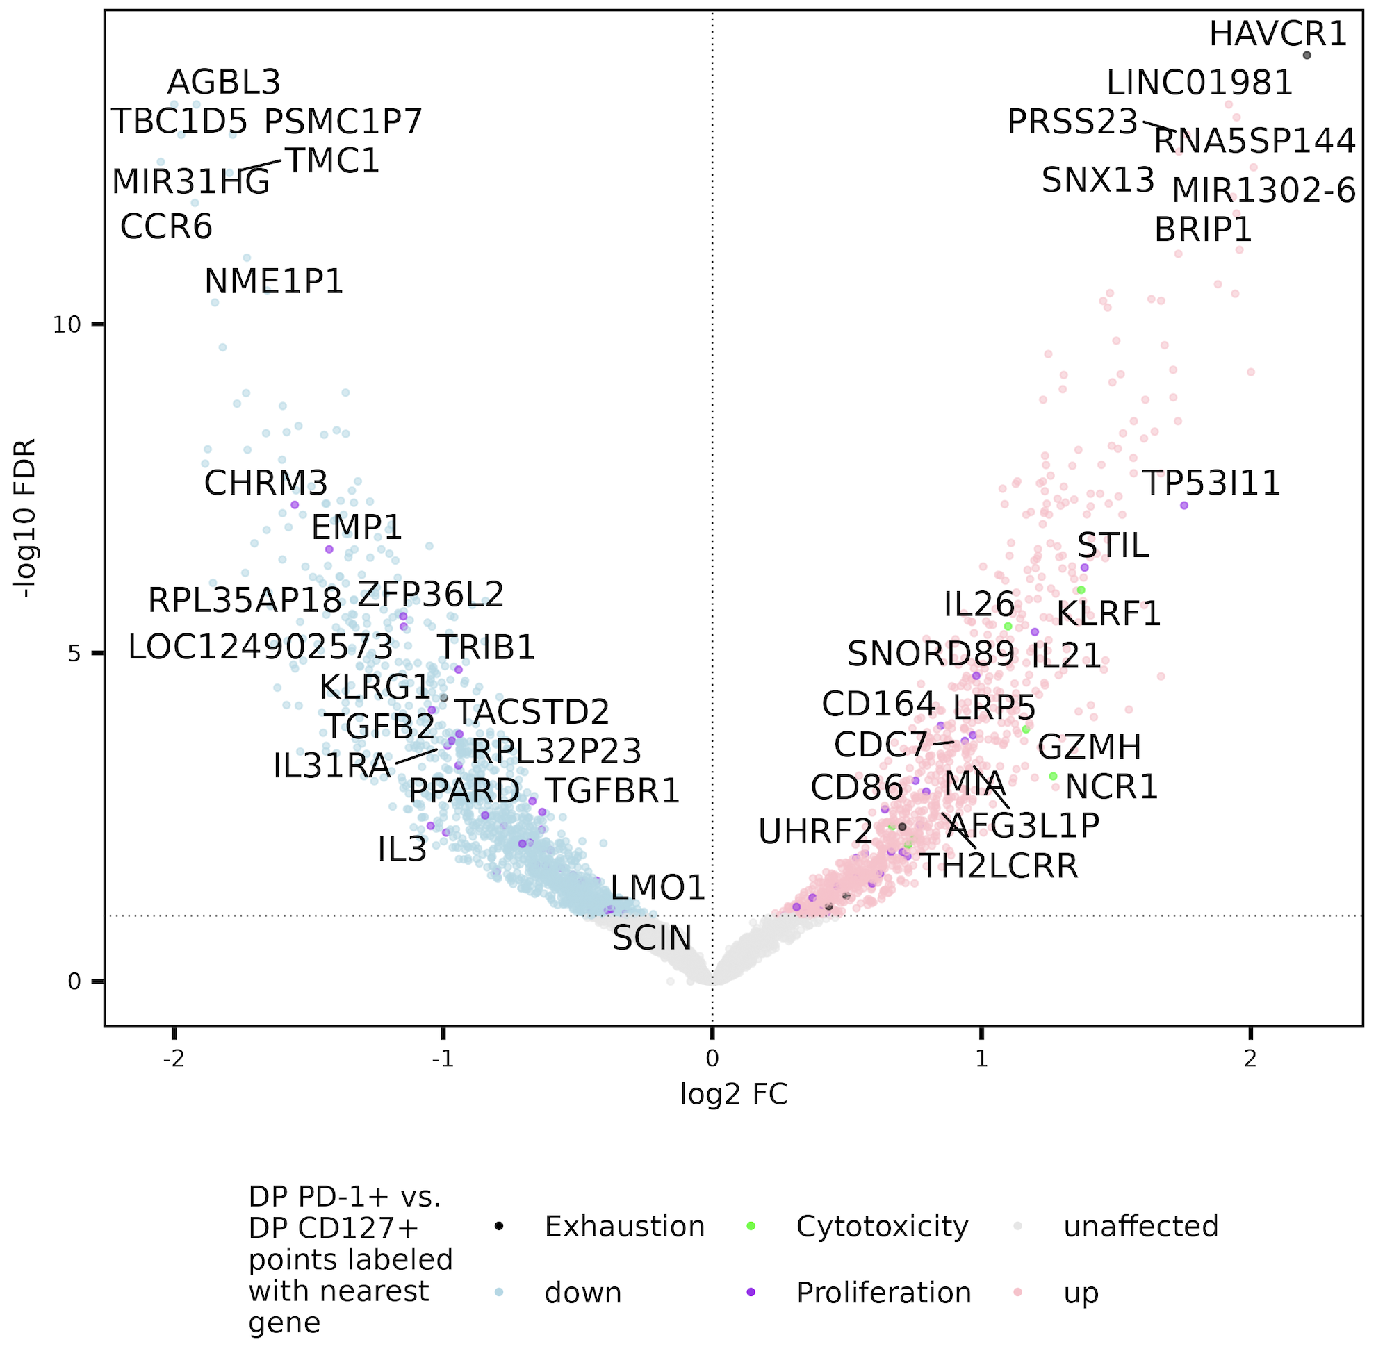
Peak near HAVCR1 gene less accessible in DP CD127⁺ vs. both other DPs, perhaps DP CD127+ less T_{ex}
Notes:
Top right hit is for HAVCR1 (IR), so maybe DP CD127 actually yes less Tex than other DPs
EOMES not always exh
grouped by nearest gene & nearest promoter before slicing to get unique peaks (so will still see ”duplicates” meaning different nearest gene and promoter)
This wasn’t visable before I don’t think (at least not in both contrasts) pre-reseq

Slide 9
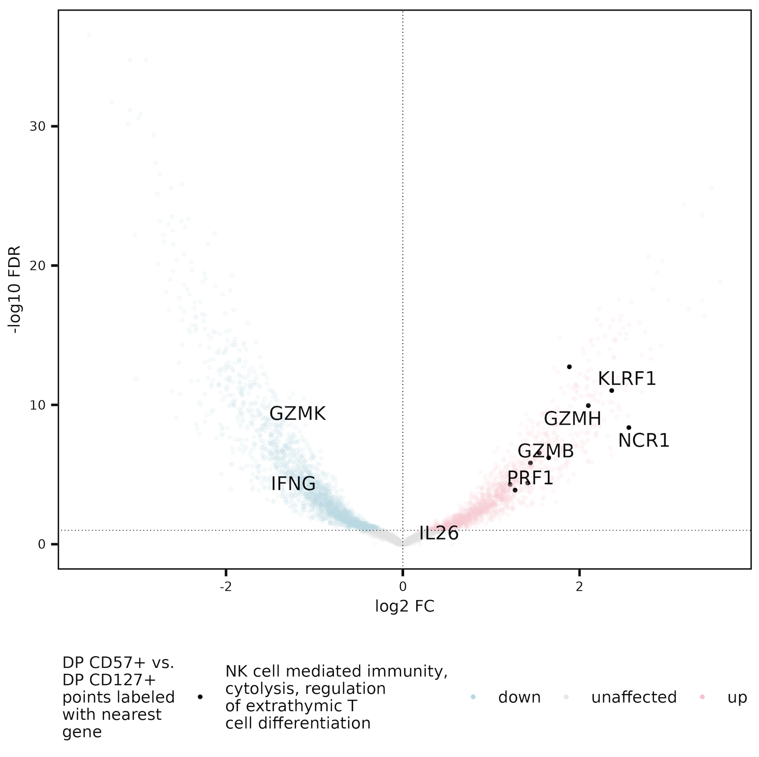
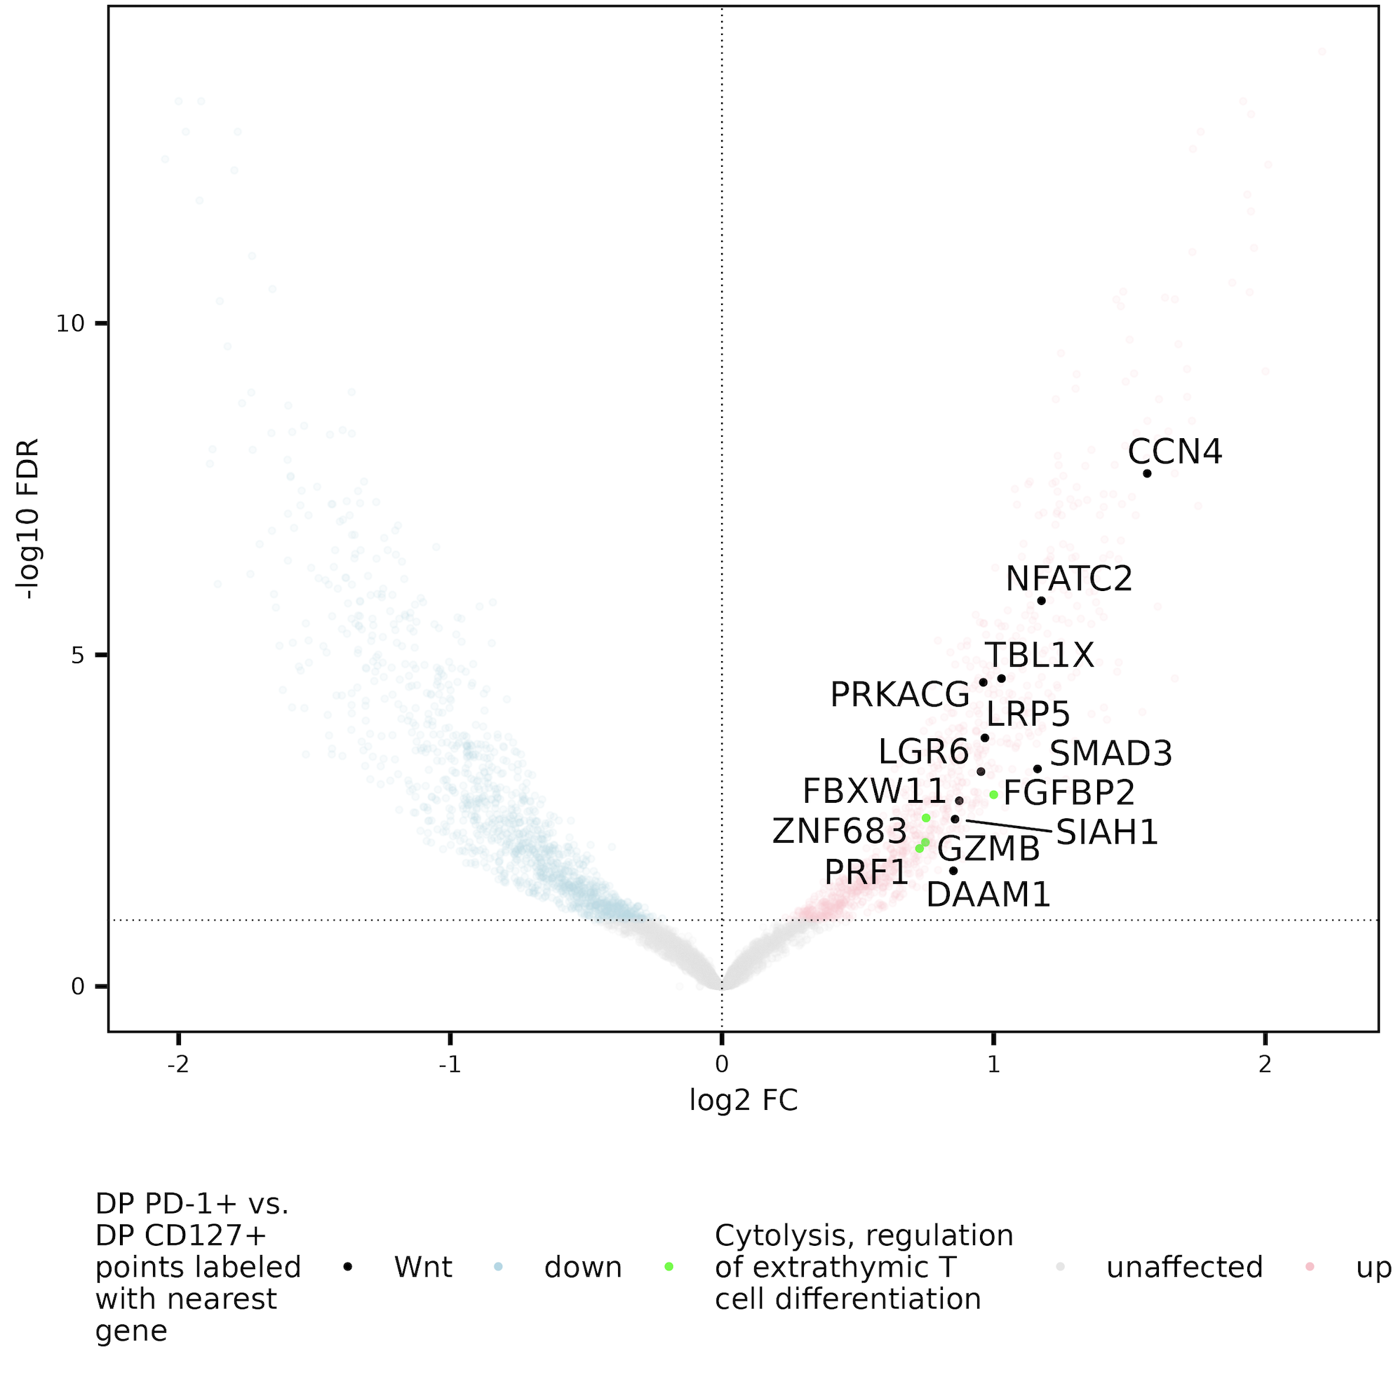
Cytolysis, regulation of extrathymic T cell differentiation gene sets enriched in DP PD-1⁺/CD57⁺ sorts vs. DP CD127⁺, so perhaps DP CD127⁺ also less T_{eff}?
Notes:
The most correct way to say title is this set (genes close to peaks more accessible in DP PD-1+ vs. DP CD127+) is enriched relative to whole genome

Slide 10
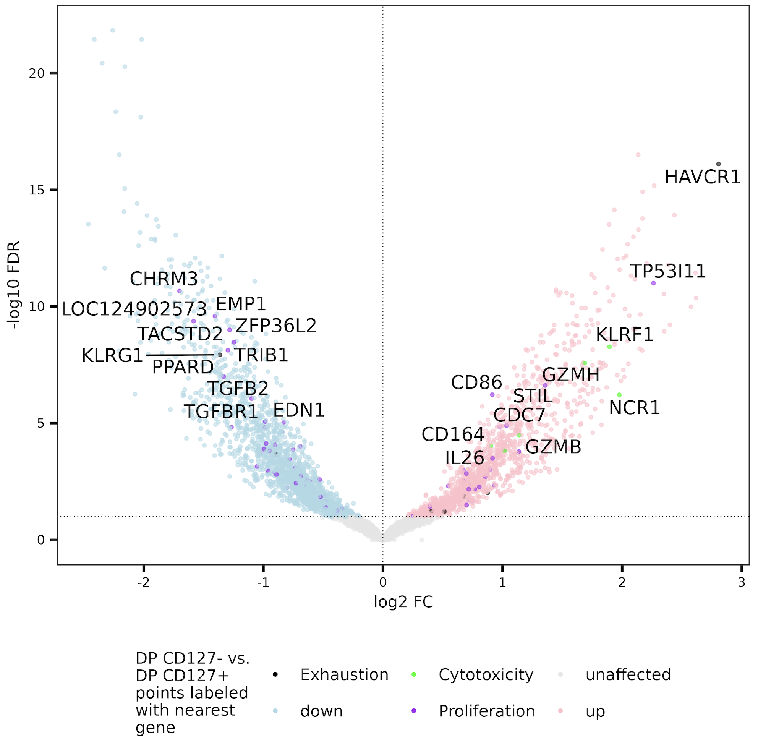
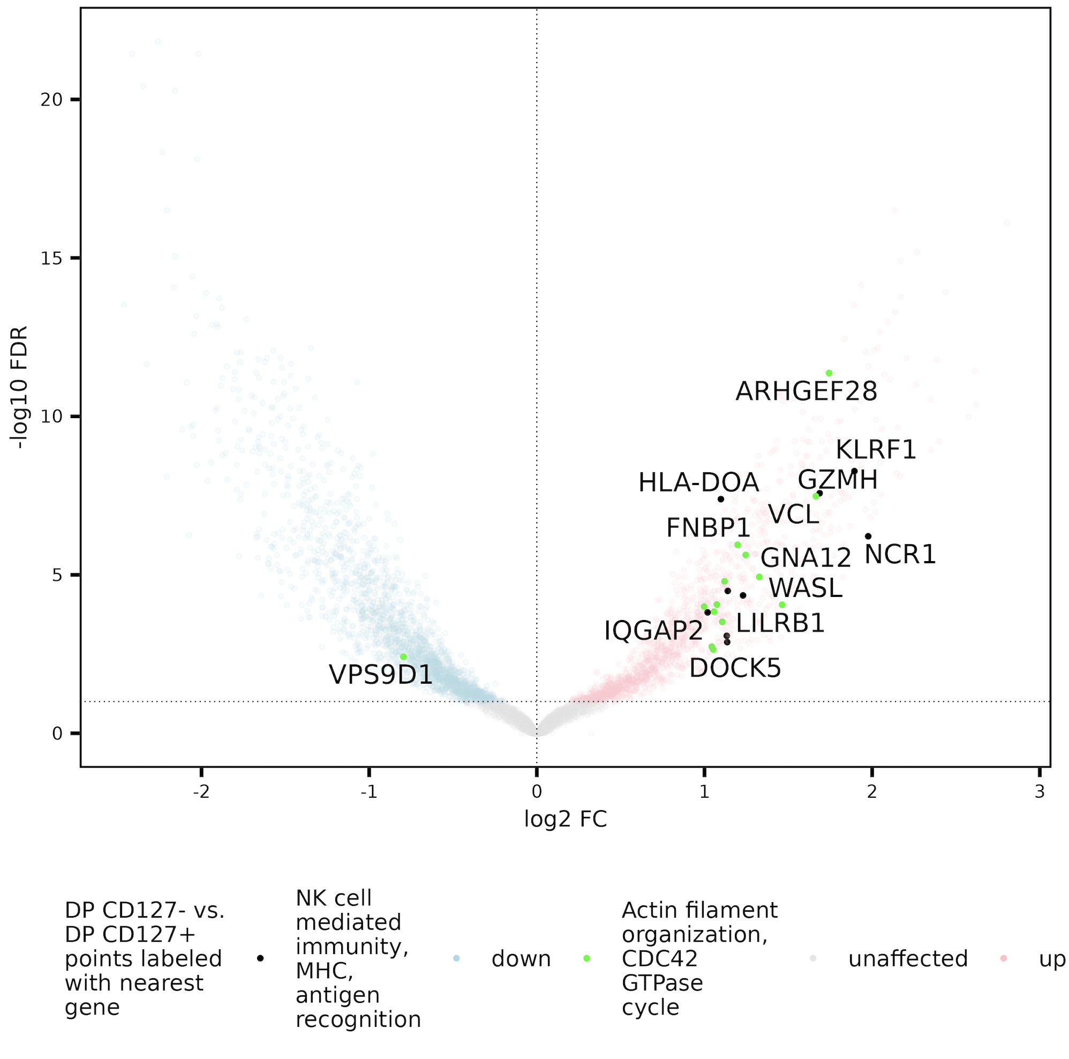
Consistent results with combining DP CD127⁻ groups in analysis
Notes:
Pretty sure I regress out effect of “sort” and just look for differences based on CD127 status within DP group… my intention being to regress out differences b/w PD-1/CD57 when using a group to compare to DP CD127+

Slide 11
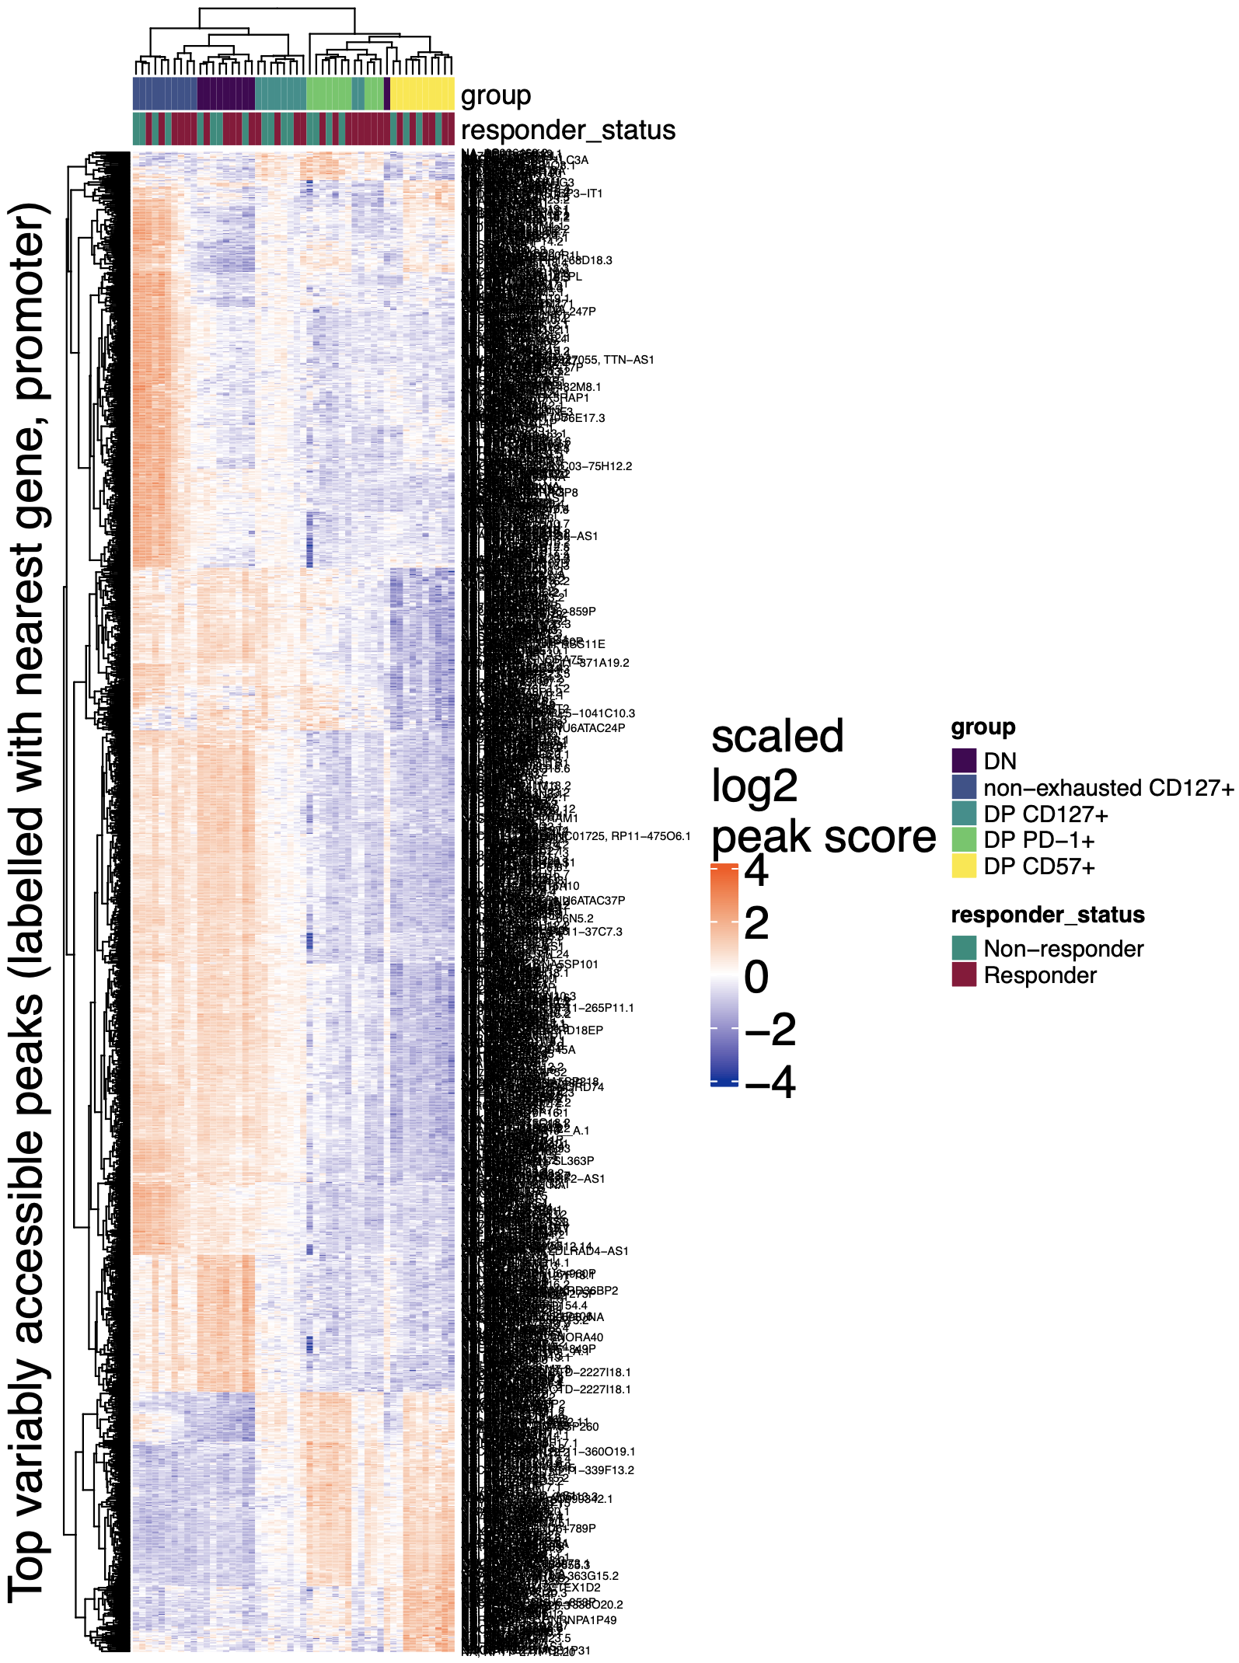
Also see enrichment of T cell differentiation (as well as regulation of immunoglobulin mediated immune response, developmental processes) in bottom block here (accessible in DP CD57⁺ and DP PD-1⁺)

Slide 12
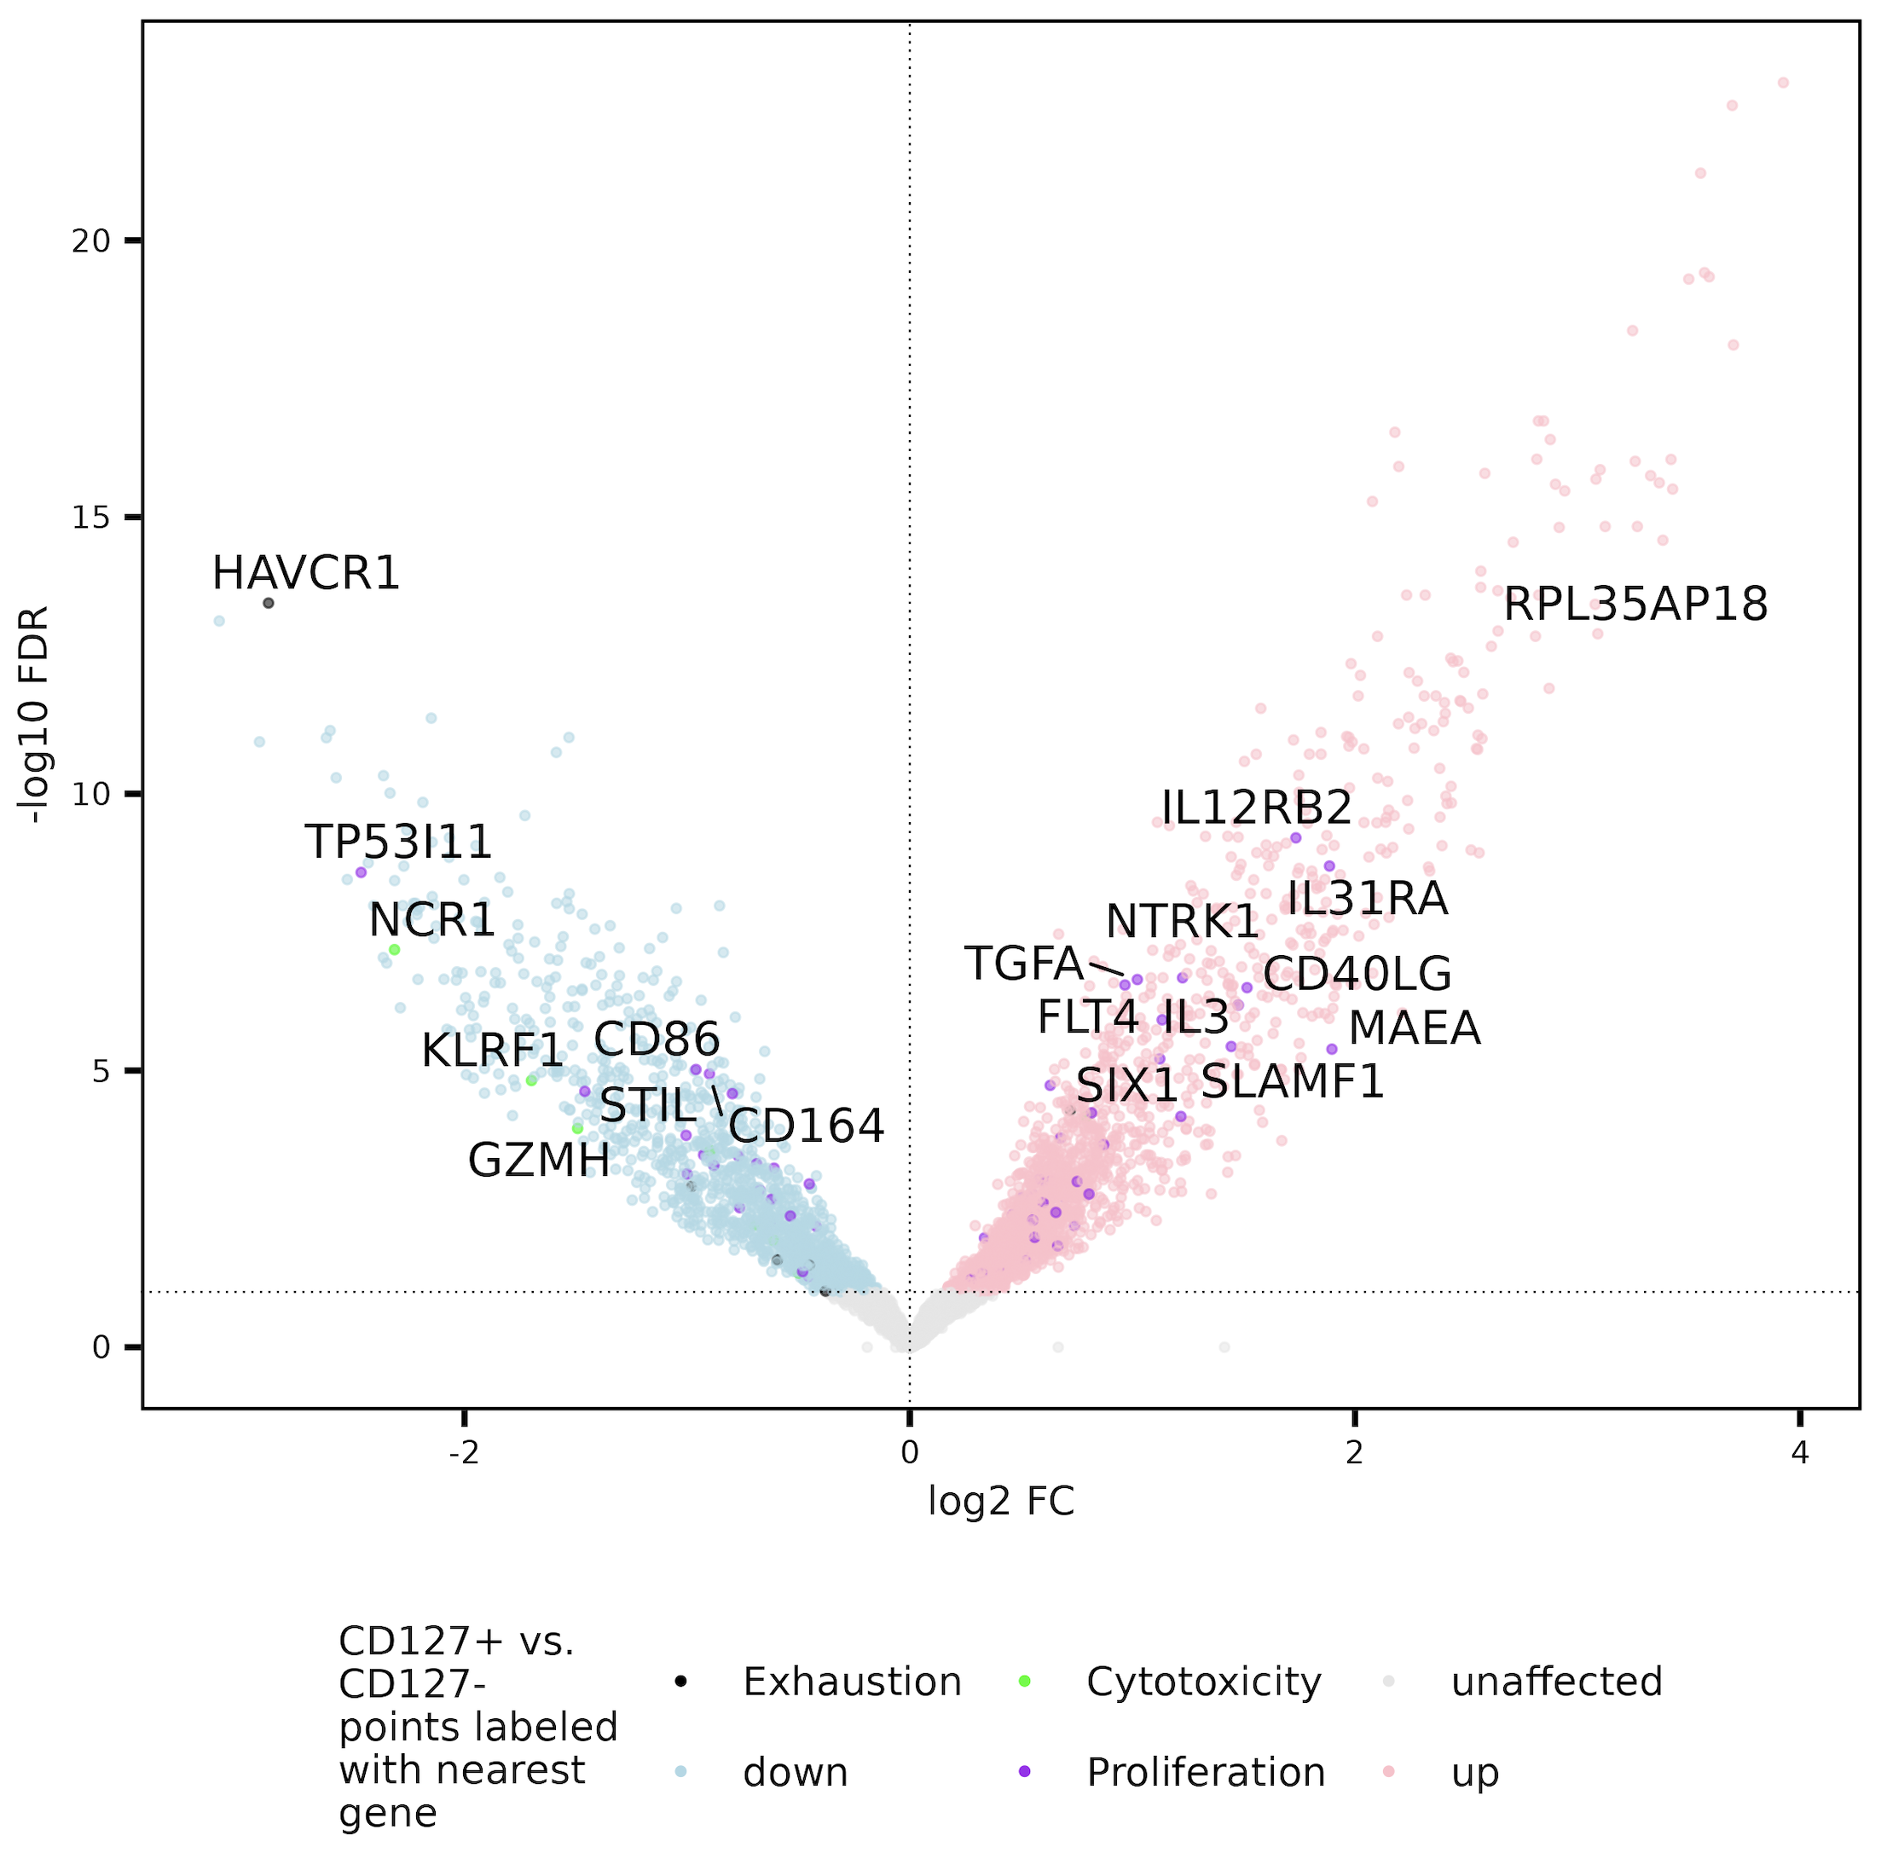
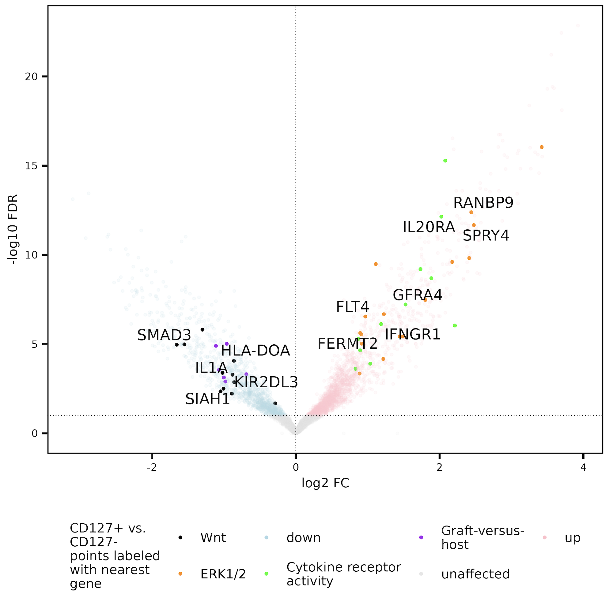
Grouped CD127⁺ up in ERK/MAPK, grouped CD127⁻ up in Wnt (appropriate to group?)
Notes:
Along with ERK1/2, also see MAPK, general intracellular signal transduction up in CD127+, meaning activation (TCRs stimulated?)
Wnt up in primed (naïve) T cells, so not sure what that means for non-naïve T cells…

Slide 13
Conclusions
MT variants: choosing params
Ref/var supporting reads cutoff fine at 2/strand
min_var_freq of 0.003 (lowest w/ strongest results)
Epigenetics
Proliferation gene set doesn’t seem enriched in any side of contrasts looked at so far (CD127 related ones)
DP CD127⁺ both less T_{ex} (HAVCR1 peak less accessible) and less T_{eff} (cytolysis gene sets less accessible)?
ERK/MAPK gene set more accessible in CD127⁺, more active?
Notes:
Point 2a: contrary to hypothesis that DP CD127⁺s for example may associate with worse outcome due to proliferating more

Slide 14
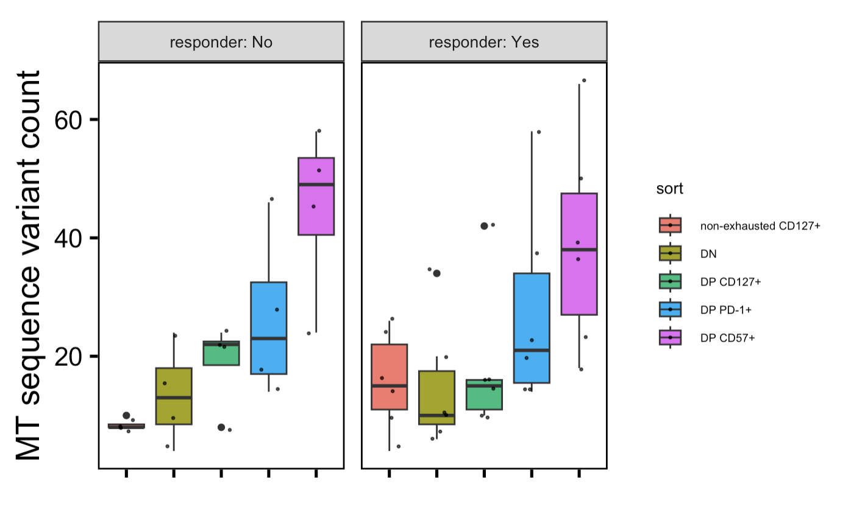
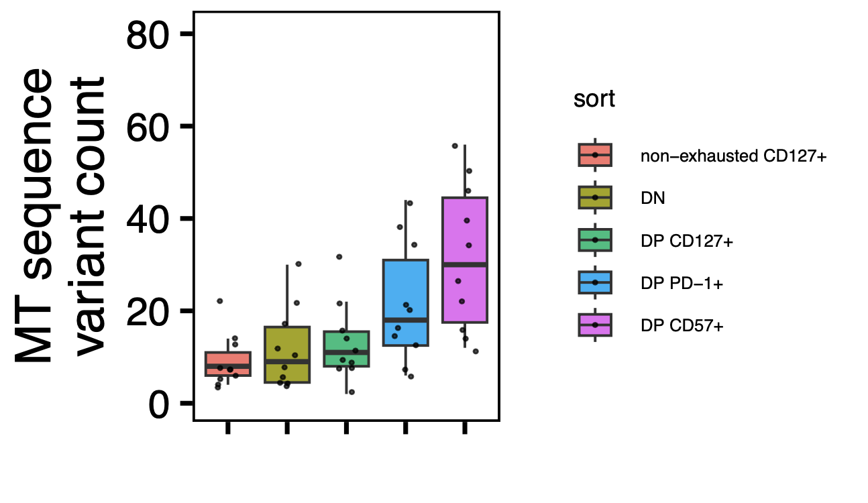
Next steps
Prepare slides for Long lab reseq update
Homer TF analyses
TEAseq analysis
w/ stats added
Notes:
Vars > 99% basically genetic fixation (unlikely to lose now given the need for the same position to mutate again with 16k genome)? And vars < 5% basically new vars, so recently acquired (since all var freqs start at 0% in a sense…)

Slide 15
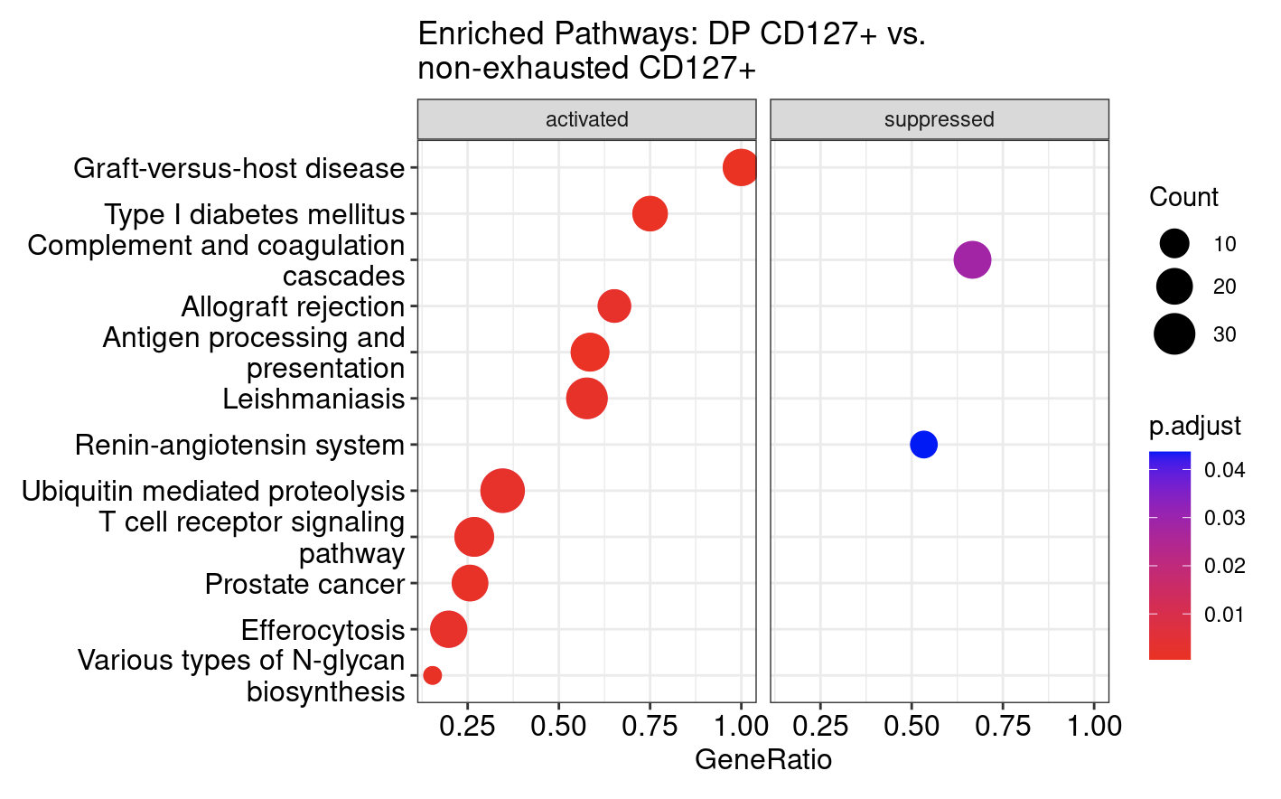
Do observe many enriched sets with stringdb/kegg methods for DP vs. non-exhausted CD127⁺

